Slide 1
Project C.A.S.P.
Week 7

Slide 2
Outline
The outline module will construct hierarchical outline markup file based on input code
This includes decision, declaration, loop statements etc.
Format into useable information for the consumer
Shows what there is

Slide 3
Lint
Lint descriptor file(provided by the user)
File exist check
no
Return notification
Yes
Decriptor file(lookup table)
Iterate over linting rules
Attempt to match the linting lookup table to patterns in the code markup file
more
Return lint result
Exit
no

Slide 4
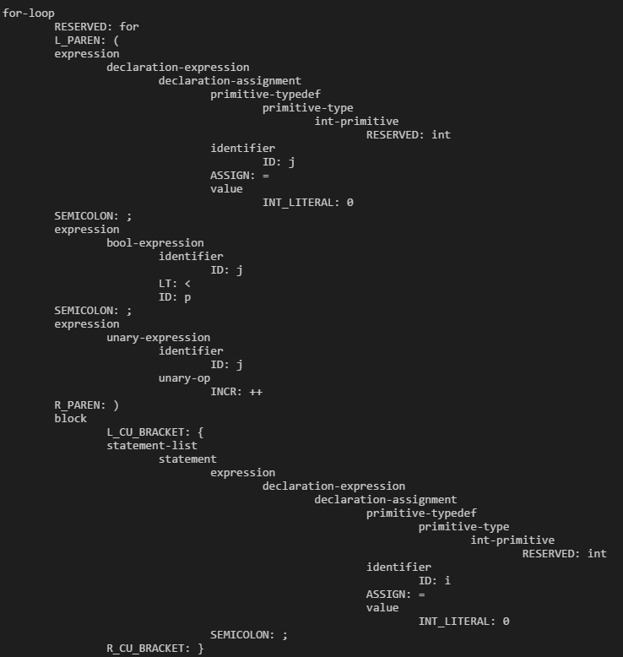
Parser issues + Fix
Issues with the parser were detected when attempting to parse a for-loop
for (int j = 0; j < p; j++) { int i = 0; }
Still have some minor issues, but they can be overlooked for a proof-of-concept
Set us back on the other modules, but all good now

Slide 5
Tasks
Ryan - Implementing Outline Module
Dylan - Implementing Analyze Module
Chris - Implementing Translate Module

Slide 6
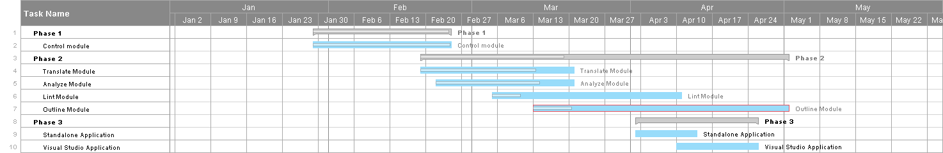
Gantt Chart

